Slide 1

Medayedu’s Analysis of Global Covid-19 Data
Name: Medayedu Ayorinde

Slide 2
Objectives
Identify the distribution of covid cases, death and recovery across the globe and identify countries with the highest number of cases and deaths. To also identity the trend of cases and death across a 3 years period.

Slide 3
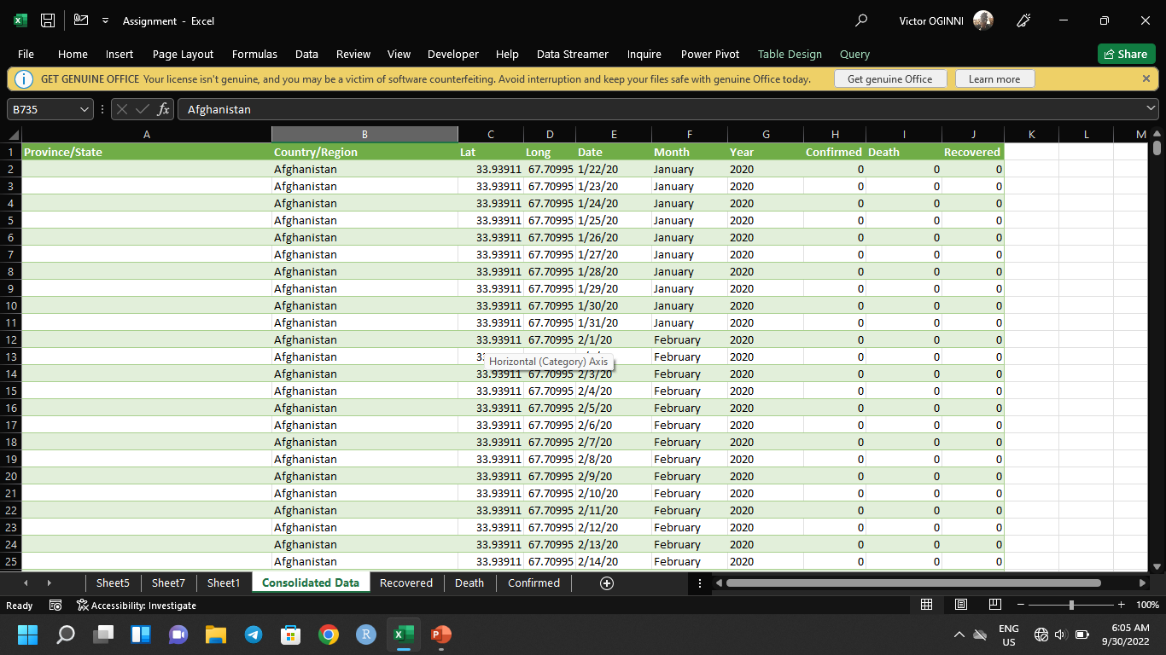
The data

Slide 4
Methodology
The analysis was carried out using Microsoft Excel
The raw datasets were cleaned and merged using Power query
Pivot tables were used to illustrate the data
Charts were used to visualize insights

Slide 5
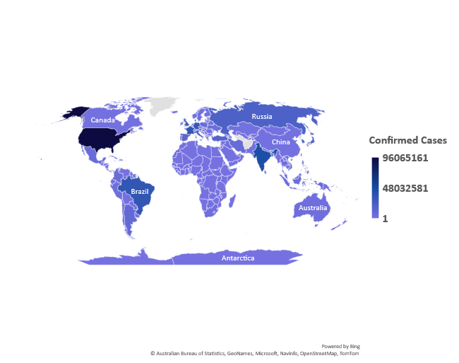
Confirmed cases

Slide 6
Confirmed Cases By Year
Number of cases

Slide 7
Confirmed Cases (Top 5)
Number of Cases

Slide 8
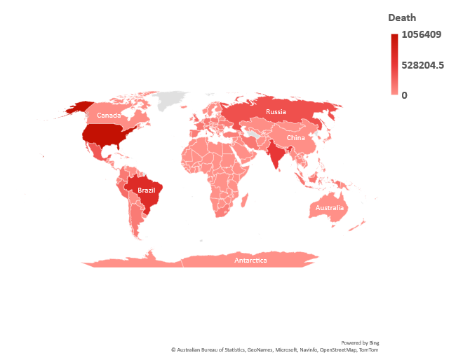
Death

Slide 9
Death Cases By Year
Death Cases

Slide 10
Death rate
Death Rate

Slide 11
Death Cases (Top 5)

Slide 12
Conclusion
It is evident from the analysis that Covid-19 is still much around as the number of cases keep increasing
People should be more careful and observe Covid-19 precautionary measures
There should be a continued vaccination drive to protect people from the virus

